Slide 1
Lecture 9
Algorithm Analysis
Arne Kutzner
Hanyang University / Seoul Korea

Slide 2
Binary Search Trees

Slide 3
Definitions
We represent a binary tree by a linked data structure in which each node is an object.
root[T ] points to the root of tree T .
Each node contains the fields
  key (and possibly other satellite data).
  left: points to left child.
  right: points to right child.
  p: points to parent. p[root[T ]] = NIL.
Algorithm Analysis
L9.<number>

Slide 4
Binary-Search-Tree Property
Stored keys must satisfy the binary-search-tree property.
  If y is in left subtree of x, then key[y] ≤ key[x].
  If y is in right subtree of x, then key[y] ≥ key[x].
Algorithm Analysis
L9.<number>

Slide 5
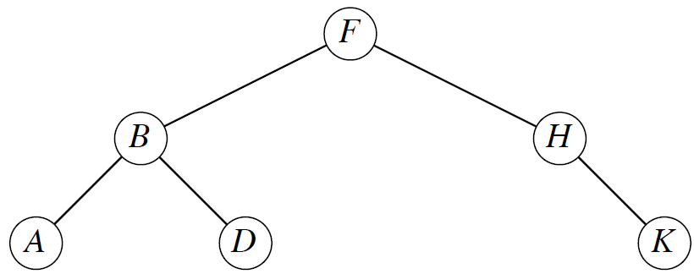
Example for Binary Search Tree
Algorithm Analysis
L9.<number>

Slide 6
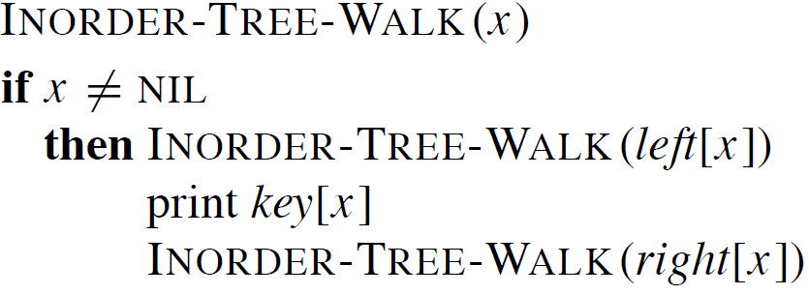
Inorder tree walk
The binary-search-tree property allows us to print keys in a binary search tree in order, recursively, using an algorithm called an inorder tree walk. Elements are printed in monotonically increasing order.
Algorithm Analysis
L9.<number>

Slide 7
Inorder tree walk (cont.)
Correctness: Follows by induction directly from the binary-search-tree property.
Time: Intuitively, the walk takes Θ(n) time for a tree with n nodes, because we visit and print each node once.
  Formal proof using recurrence and substitution method
Algorithm Analysis
L9.<number>

Slide 8
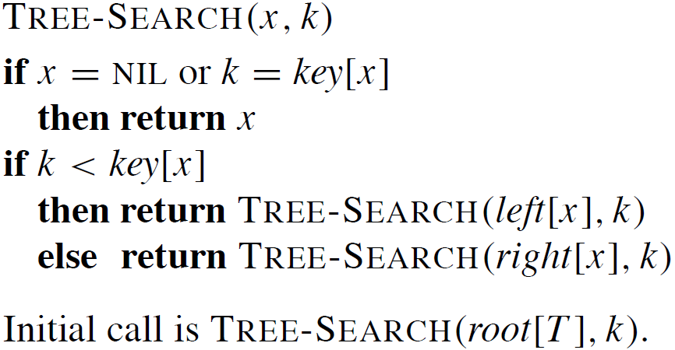
Searching
Time: The algorithm recurses, visiting nodes on a downward path from the root. Thus, running time is O(h), where h is the height of the tree.
Algorithm Analysis
L9.<number>

Slide 9
Minimum and Maximum
The binary-search-tree property guarantees that the minimum key of a binary search tree is located at the leftmost node, and the maximum key of a binary search tree is located at the rightmost node.
Traverse the appropriate pointers (left or right) until NIL is reached.
Algorithm Analysis
L9.<number>

Slide 10
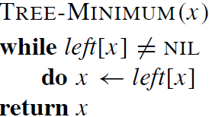
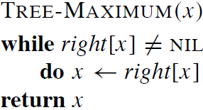
Maximum and Minimum(cont.)
Time: Both procedures visit nodes that form a downward path from the root to a leaf. Both procedures run in O(h) time, where h is the height of the tree.
Algorithm Analysis
L9.<number>

Slide 11
Successor and Predecessor
Assuming that all keys are distinct, the successor of a node x is the node y such that key[y] is the smallest key > key[x].
  We can find x’s successor based entirely on the tree structure. No key comparisons are necessary.
If x has the largest key in the binary search tree, then we say that x’s successor is NIL.
Algorithm Analysis
L9.<number>

Slide 12
Successor and Predecessor (cont.)
There are two cases:
If node x has a non-empty right subtree, then x’s successor is the minimum in x.s right subtree.
If node x has an empty right subtree, notice that: As long as we move to the left up the tree, we are visiting smaller keys. x’s successor y is the node that x is the predecessor of (x is the maximum in y’s left subtree).
Algorithm Analysis
L9.<number>

Slide 13
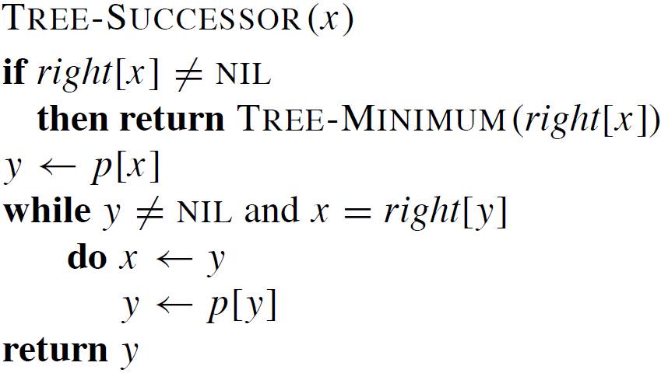
Successor and Predecessor
(Pseudocode)
moving upwards in the tree
Algorithm Analysis
L9.<number>

Slide 14
Successor and Predecessor
TREE-PREDECESSOR is symmetric to TREE-SUCCESSOR.
Time: For both the TREE-PREDECESSOR and TREE-SUCCESSOR procedures, in both cases, we visit nodes on a path down the tree or up the tree. Thus, running time is O(h), where h is the height of the tree.
Algorithm Analysis
L9.<number>

Slide 15
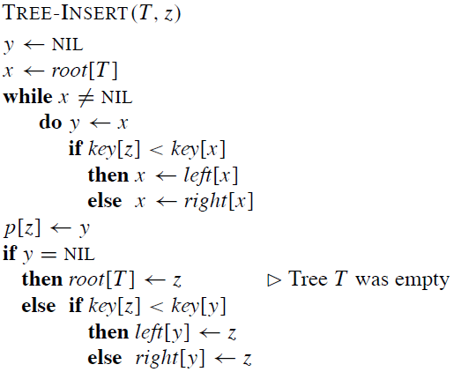
Insertion
node to be inserted
moving downwards the tree to the insertion position
placement of the new node
Algorithm Analysis
L9.<number>

Slide 16
Insertion (remarks)
To insert value v into the binary search tree, the procedure is given node z, with key[z] = v, left[z] = NIL, and right[z] = NIL.
Beginning at root of the tree, trace a downward path, maintaining two pointers.
  Pointer x: traces the downward path.
  Pointer y: trailing pointer. to keep track of parent of x.
Traverse the tree downward by comparing the value of node at x with v, and move to the left or right child accordingly.
When x is NIL, it is at the correct position for node z.
Compare z’s value with y’s value, and insert z at either y’s left or right, appropriately
Algorithm Analysis
L9.<number>

Slide 17
Insertion (Complexity)
Time: Same as TREE-SEARCH. On a tree of height h, procedure takes O(h) time.
TREE-INSERT can be used with INORDER-TREE-WALK to sort a given set of numbers.
(Exercise: What is the complexity of this approach?)
Algorithm Analysis
L9.<number>

Slide 18
Deletion
We have to distinguish three cases:
Case 1: z has no children. Delete z by making the parent of z point to NIL, instead of to z.
Case 2: z has one child. Delete z by making the parent of z point to z’s child, instead of to z.
Case 3: z has two children. z’s successor y has either no children or one child.
(y is the minimum node - with no left child - in z’s right subtree.)
Delete y from the tree (via Case 1 or 2). Replace z’s key and satellite data with y’s.
Algorithm Analysis
L9.<number>

Slide 19
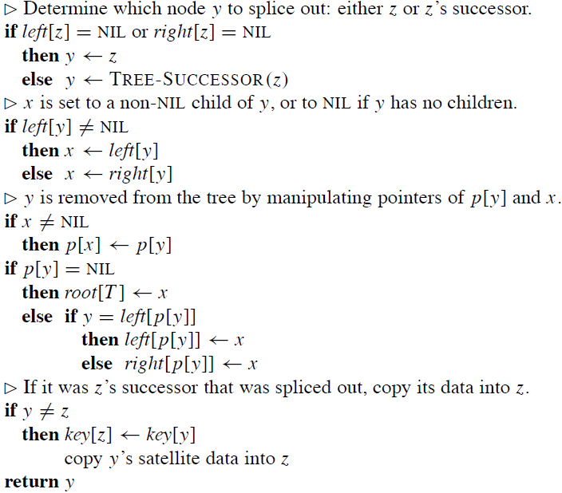
Pseudocode
Delete
y is the node to splice out
Algorithm Analysis
L9.<number>

Slide 20
Delete (Complexity)
Time: O(h), on a tree of height h.
Algorithm Analysis
L9.<number>

Slide 21
Minimizing running time
We’ve been analyzing running time in terms of h (the height of the binary search tree), instead of n (the number of nodes in the tree).
  Problem: Worst case for binary search tree is (n).no better than linked list.
  Solution: Guarantee small height (balanced tree).h = O(lg n).
In later chapters, by varying the properties of binary search trees, we will be able to analyze running time in terms of n.
  Method: Restructure the tree if necessary. Nothing special is required for querying, but there may be extra work when changing the structure of the tree (inserting or deleting).
Algorithm Analysis
L9.<number>

